Slide 1


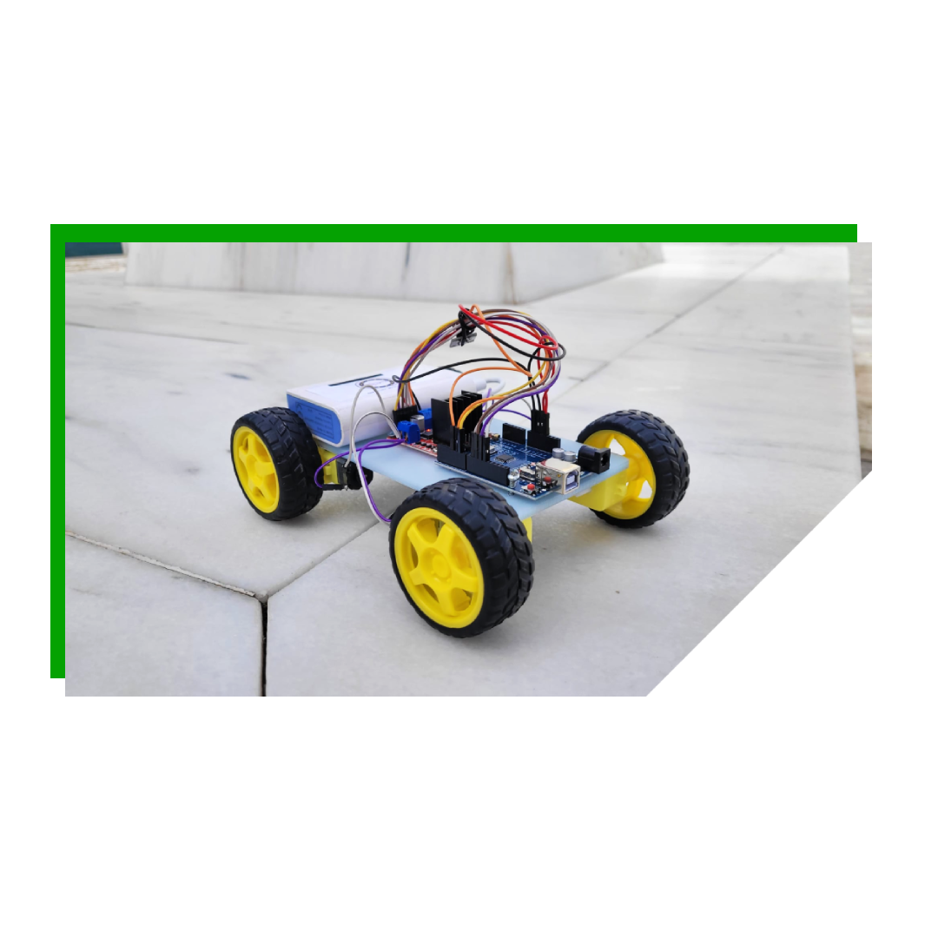
Remote Control Arduıno Car
Umut Bora GÖÇ
Metin Can AKÇİL
Ahmet
TOPAK
Ekrem
ÖZDEMİR
Tarkan K. ERTUĞRUL
Notes:
We will like to introduce to you HOW our project
named
"Remote Control Arduıno Car" WORKS.
Right after the presentation,
you will have the opportunity to BUILD the car.
Let's go to the presentation

Slide 2
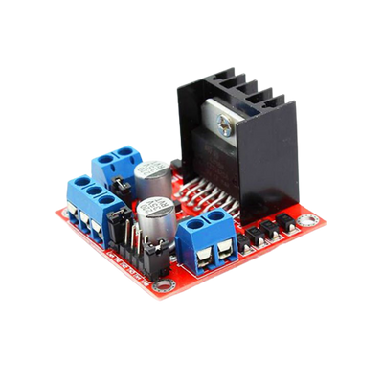
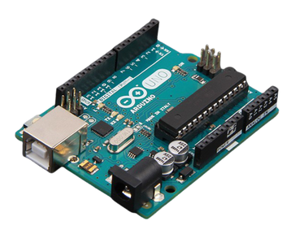
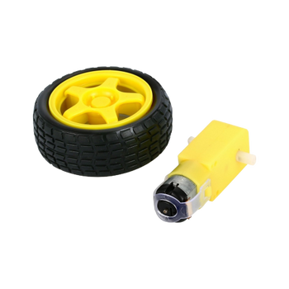
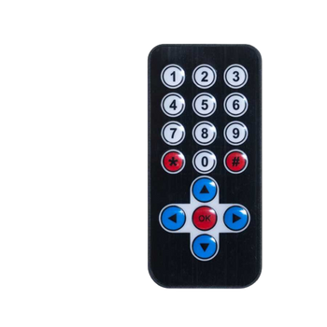
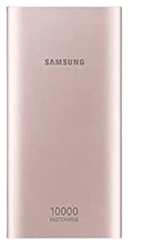
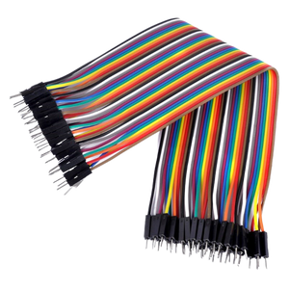
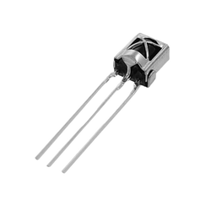
MATERIALS
Arduino Board
Engine Driver Board
Engine & Wheel
Remote Control
&
IR sensor
Power Bank
Cables
Notes:
In this project, we used Arduino Board,
Engine,
Engine Driver Board,
Cables,
Power Bank,
Remote Control and IR Censor.

Slide 3

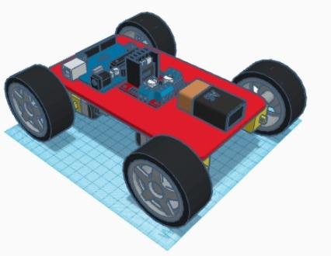
PROCEDURE
WE PRINTED THE SKELETON OF THE VEHICLE WITH A 3D PRINTER
Notes:
The body of our vehicle(viyekıl)
you see in this picture
was modeled
using the program TinkerCad.
In our school's
3D printing laboratory,
we printed
the body of our vehicle
using a 3D printer

Slide 4
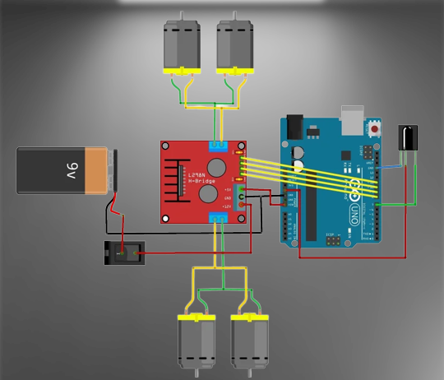
Arduino Board Diagram
Showing The Connections.
Notes:
Now
we will provide you
with the instruction manual on
how to
connect the cables,
Arduino board,
motor driver,
battery and
remote control.

Slide 5
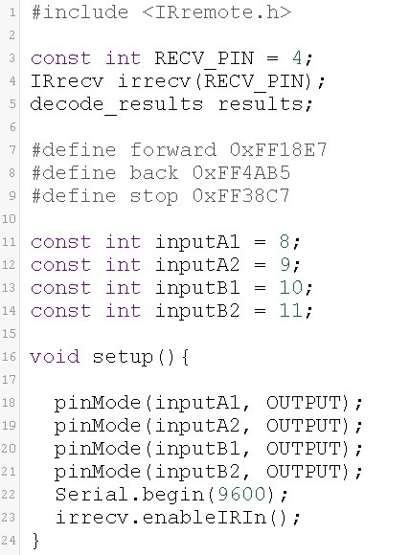
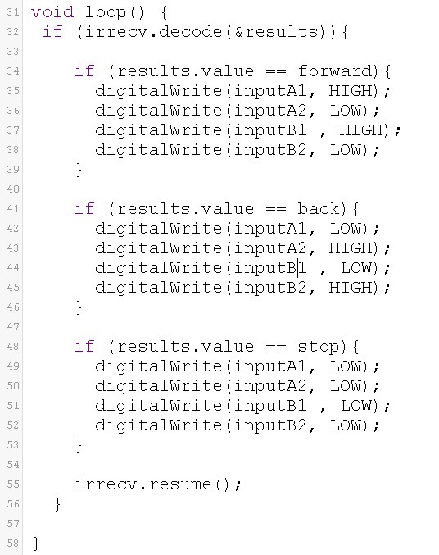
Notes:
At this time,
we will send you
the codes
DIRECTLY to your PC.

Slide 6
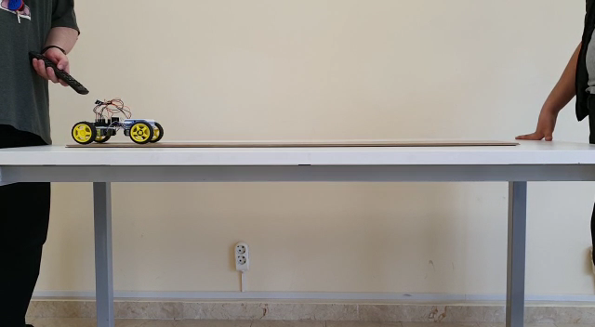
Notes:
First,
we will watch the Tracker videos.
In our experiment,
we performed MULTIPLE tests.
OUR first test
was done
with the car's constant speed RUNNING
at a FLAT level.

Slide 7
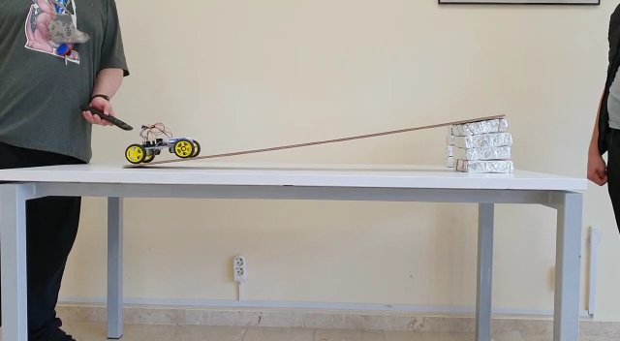
Notes:
Using
brick foams,
that (dhat) we made,
we tested
the "car's speed"
at different HEİGHT levels
with the wooden ramp,
in order to get
our results.
Here is the video showing,
how the Arduino car
climbs (kılaymps) the ramp.

Slide 8
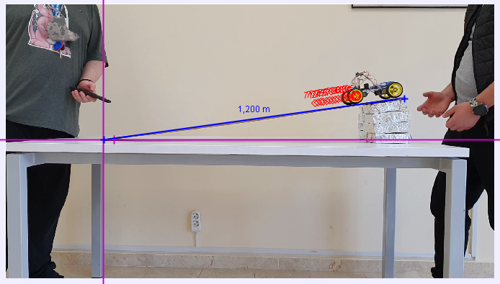
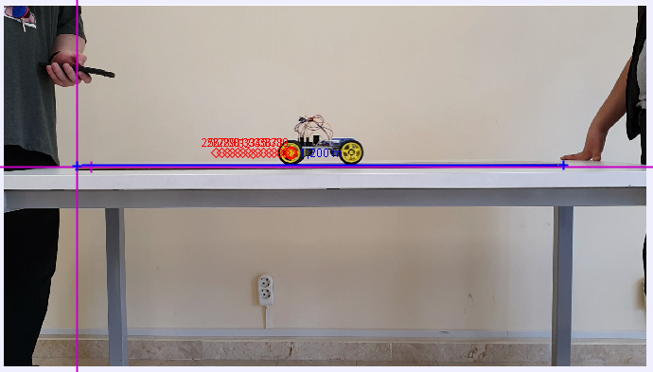
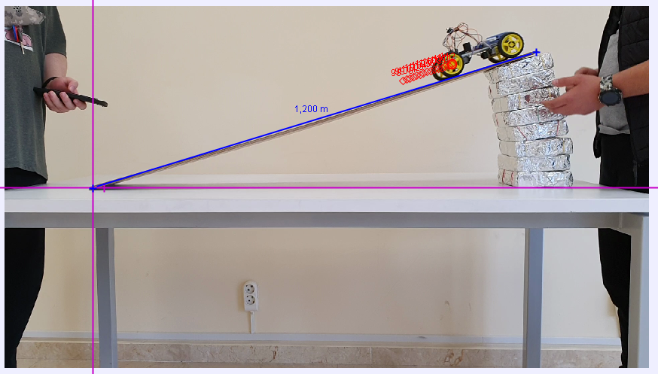
Notes:
The 3 (three) different levels of height that (dhat) we use were (WÖR):
Zero or flat level
Then, a total (todıl) of 4( four) bricks were (WÖR) used
for our second test.
And, finally, we used
the maximum total of 8 (eight) bricks.

Slide 9


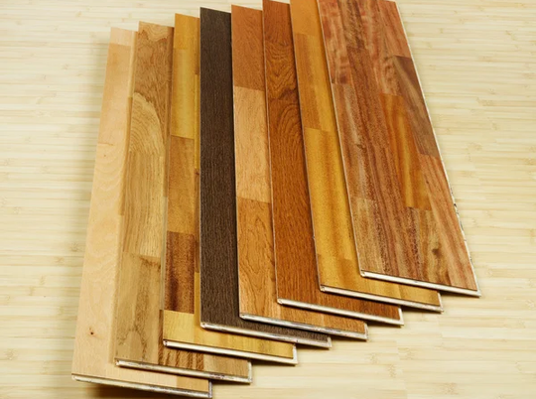
= 554.5g
= 1.20 m
Notes:
Please,
keep in mind,
our Arduino car weights (Veyhts)
554.5g (five hundred fifty four gram)
AND the wooden ramp distance (Distins) IS
1.20 (one point twenty) meters in length (leength).
These values (velyus) are needed for
THE Tracker program.

Slide 10
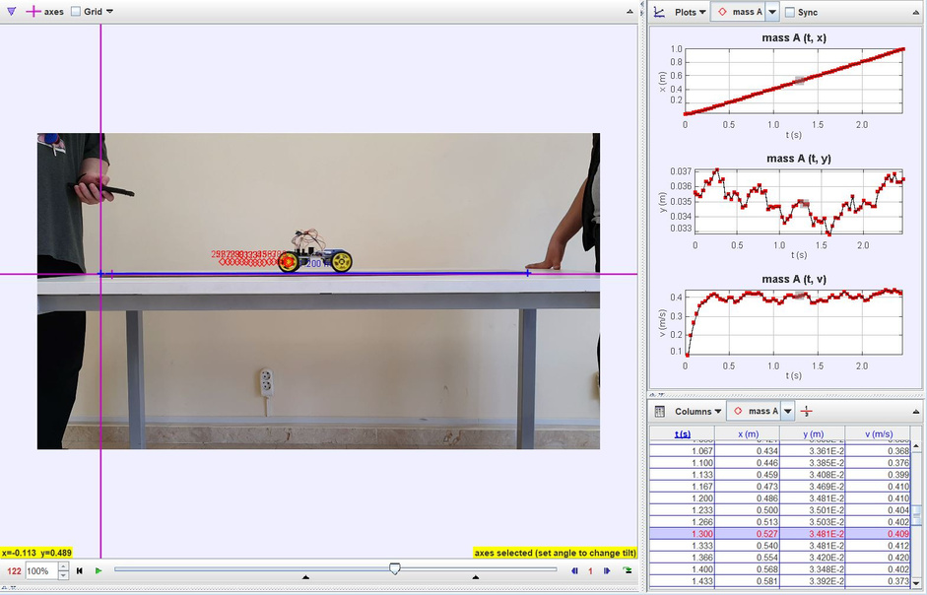
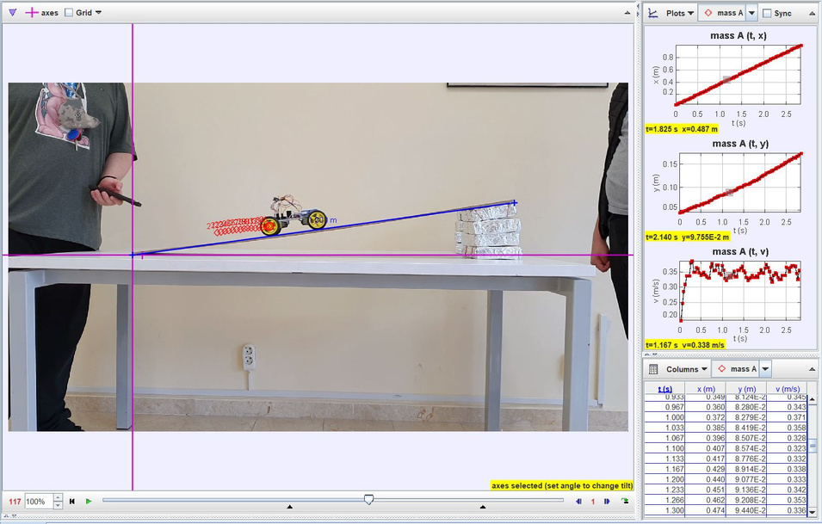
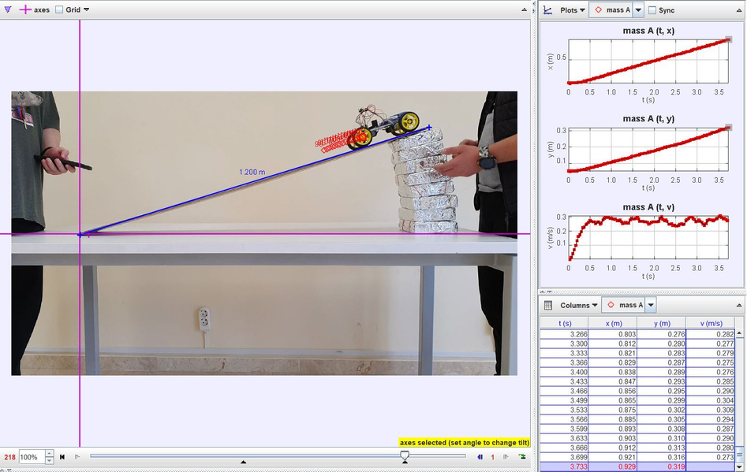
Notes:
Now,
we will show
the results
of our experiment.
When the car runs without
any ramp height,
the car's speed is CONSTANT (konstınt)and without any speed reduction (ridakşın).
When the car runs on ANY ramp height (hayt),
the car's speed will
slow down
at any angle due to
it's weight and friction
from the incline.

Slide 11



V= X/T
Distance
Velocity = ------------
Time
=
Notes:
We have been ABLE to prove (puruv)
the formula
V=X/T (Velocity
equals
distance
divided by time )
does apply (eplay) to this project
with the results of
our Tracker graph's speed (sipiid) outputs.

Slide 12
IF I RAISE THE RAMP, WILL THE SPEED OF THE CAR SLOW DOWN?
CONCEPT
MATERIALS
We have examined a vehicle with the
V= X/T (Velocity equals Distance divided by Time) formula and its compliance with the laws of physics.
ARDIUNO BOARD
ENGINE DRIVER BOARD
ENGINE
CABLES
REMOTE CONTROL
IR SENSOR
POWER BANK
YES
PRINCIPLES
AND LAWS
PROCEDURE
CONCLUSION
Newton’s 2nd Law of Motion states that every object persists in its state of rest or uniform motion in a straight line unless it is compelled to change that state by forces impressed on it.
Commanding different actions to compensate for the vehicle's increased speed shows in the Tracker Graph how Newton's Second Law of Motion is supported.
Notes:
Here
we HAVE
a small summary of the project’s process.
As for the question;
IF
I raise the ramp,
WILL
the speed of the car
slow down?
The answer is YES.
Newton's 2nd Law of Motion
stating that
every object,
like our car,
PERSISTS
in its state of rest
or uniform motion
in a straight line
unless
it is compelled to change that state
by force
impressed on it.
This Law
has been proven
in our project experiment.

Slide 13
Conclusion
Commanding different actions to compensate for the vehicle's increased speed shows in the Tracker Graph how Newton's Second Law of Motion is supported.
Notes:
Commanding
different actions
to compensate
for the vehicle's increased speed
SHOWS
in the Tracker Graph
how
Newton's Second Law of Motion
is supported.

Slide 14

Notes:
Thanks for listening.

